Slide 1
Cross-Site Scripting (XSS)
Luka Cvetko
Wayne State University
Department of Computer Science

Slide 2
Table of contents
What is XSS?
Demonstrate attack
1
2
Defense tactics
Demonstrate protection
3
4
Define XSS attacks and its different types.
Demonstrate a XSS attack on VM
Demonstrate protection method used.
Show different ways of protection against XSS attacks.

Slide 3
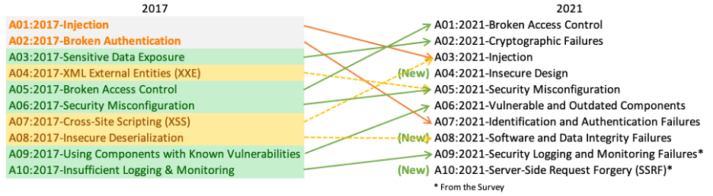
Cross-Site Scripting
Form of injection attack, where an attacker executes malicious code into a safe website.
The code targets the web application content and is delivered to the victim's browser as they interact with the website.
Enables potential access of cookies, user’s website data and can even take over the session.
3rd most prevalent issue in OWASP Top 10, affects roughly 2/3 of applications.

Slide 4
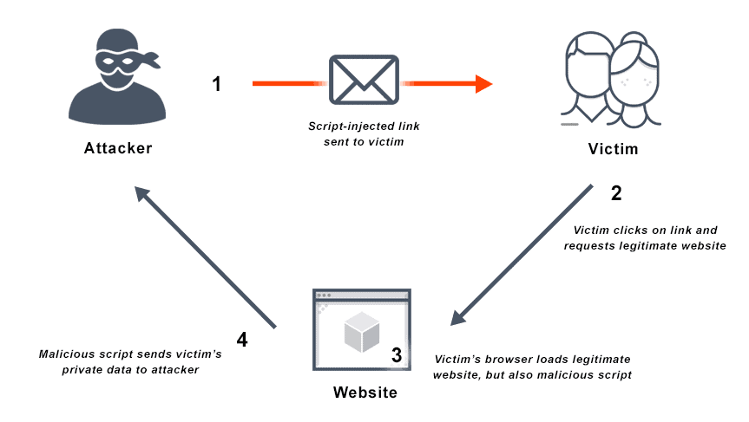
Why are they so prevalent?
Most applications run on internet-accessible web servers, and posses the ability to collect and display user data – comment section, username-password field etc.
XSS attack happen when the application accepts user input, which is then poorly sanitized.
A malicious user can then post malicious data into the user input area in order to manipulate how the application operates or what data is returned.
Code is entered in the language of the application (JavaScript) and executed on the server-side interpreter.
Web-apps are made by people and people make mistakes, one small mistake in a field can make the whole application vulnerable.

Slide 5
Types of attack
Stored XSS
Web application immediately returns a user input in an error message, use phishing email or advert to trick a user
Reflected XSS
User-input not properly sanitized and stored to server-side; comments
DOM-based XSS
Attacker can control some part of the client-side JavaScript used in the page; DOM elements affected

Slide 6
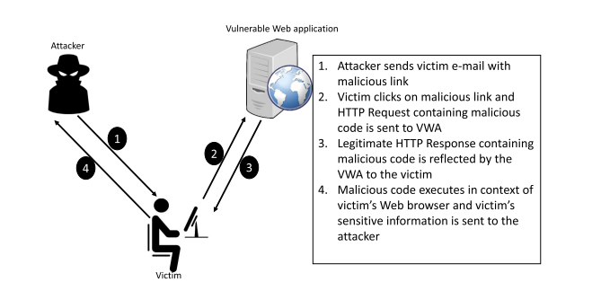
Reflected XSS attack

Slide 7
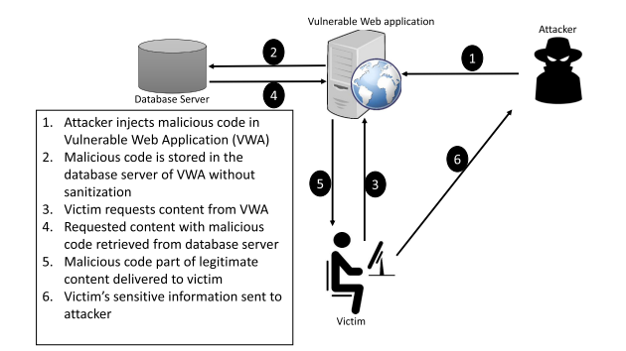
Stored XSS attack

Slide 8
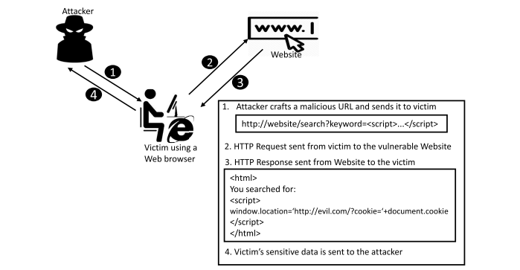
DOM-based XSS attack
http://example.com/process?value=2
const num = document.URL.split(“value=”)[1];
document.getElementById(“displayValue”).innerHTML = eval(num);
http://example.com/process?value=<script>...</script>

Slide 9
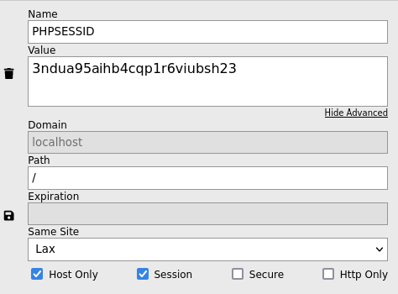

Defensive methods
Do not trust any user input
  Simple yet effective technique is to pass every inputted data via a security filter that detects and removes harmful keywords. For example, filter the HTML <SCRIPT> tag.
Use escaping/encoding
  Modifies certain standard characters in the user’s data and ensures they are not interpreted as active content.
Sanitize HTML
  Security-focused library for parsing and cleaning the HTML formatted text
Use Content Security Policy (CSP)
  Whitelist the trusted sources in HTTP headers.
Cookie security & Same Site Attribute

Slide 10
Implementation
Simple yet effective solution that will filter out malicious data in the attacked website.
htmlspecialchars() function -> <script>location.href('http://www.malicious.com')</script> stored as &lt;script&gt;location.href('http://www.malicous.com')&lt;/script&gt;
Also added the function which will strip all unnecessary characters (extra space, new line, tab etc.) and added a function which will remove “\” from user input fields.
function test_input($data) {
$data = trim($data);
$data = stripslashes($data);
$data = htmlspecialchars($data);
return $data;
}

Slide 11
References
Upasana Sarmah, D.K. Bhattacharyya, J.K. Kalita, A survey of detection methods for XSS attacks, Journal of Network and Computer Applications, Volume 118, 2018, Pages 113-143, ISSN 1084-8045, https://doi.org/10.1016/j.jnca.2018.06.004. (https://www.sciencedirect.com/science/article/pii/S1084804518302042)
Cross Site Scripting Prevention - OWASP Cheat Sheet Series
A Practical Guide To Understanding Cross-Site Scripting (XSS) Attacks (securecoding.com)
Cross-site Scripting (XSS) simplified: What is it & how to prevent it? (dltlabs.com)
Loi Liang Yang. (2021, April 18). Cross-Site Scripting (XSS) Explained And Demonstrated By A Pro Hacker! [Video]. YouTube. https://www.youtube.com/watch?v=PPzn4K2ZjfY
David Bombal. (2022, April 29). Website Hacking Demos using Cross-Site Scripting (XSS) - it’s just too easy! YouTube. https://www.youtube.com/watch?v=PzRQhpbYbeg
OWASP Top Ten | OWASP Foundation. (n.d.). https://owasp.org/www-project-top-ten/

Slide 12

Q/A

